Slide 1
Lab 8 “Purely a Matter of Taste” Inference for a Population Proportion
STAT 201: Elementary Statistics

Slide 2
Taste Test
Are name brand products really worth the extra money?
We will compare a name brand food and drink product to the Publix brand alternative of that food or drink.
½ of you will set up the test for a drink product.
Mott’s Apple Juice (name brand)
Publix Apple Juice (bargain brand)
½ of you will set up the test for a food product.
Nabisco Vanilla Wafers
Publix Vanilla Wafers

Slide 3
Taste Test
You will not taste any items in this room but you will taste the items set up in the other rooms:
You are not required to taste anything.
If you are allergic to a product do not consume it.
LeConte 200A: Coca Cola vs Publix Cola and Chips Ahoy Chocolate Chip cookies vs Publix Chocolate Chip cookies.
LeConte 124: Sprite vs. Publix Lemon Lime soda and Keebler Fudge Stripe Cookies vs Publix Fudge Stripe Cookies

Slide 4
Step 1: Randomly Assign Product Label
Instructor will flip a coin to determine which food item is labelled X and which is labelled Y:
If coin lands on Heads then …
Nabisco vanilla wafer (name brand) is Y.
Publix vanilla wafer (bargain brand) is Z.
If coin lands on Tails then …
Nabisco vanilla wafer (name brand) is Z.
Publix vanilla wafer (bargain brand) is Y.
Instructor will flip a coin to determine which drink item is labelled X and which is labelled Y:
If coin lands on Heads then …
Mott’s apple juice (name brand) is Y.
Publix apple juice (bargain brand) is Z.
If coin lands on Tails then …
Mott’s apple juice (name brand) is Z.
Publix apple juice (bargain brand) is Y.
Fill in Table 8.2 on page 61.

Slide 5
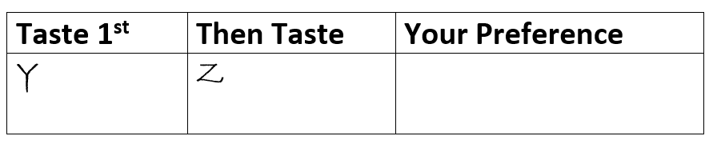

Step 2: Randomly Decide the Tasting Order for each Student that will Taste the Product
Each student will draw a bead out of the bucket on the table to randomize the order each student is to taste the products.
Fill out the following sheets provided to you:
If you drew a white bead then fill out the sheet provided with the following order:
If you drew a non-white bead then fill out the sheet provided with the following order:
Each student will do this 4 times (there needs to be 48 sheets ready when tasters come in).

Slide 6
Step 3: Set up the Product as a Single Blind Test
Tables 1 and 2 will count out 48 coffee filters (for the name brand Vanilla Wafers) or 48 cups (for the name brand Apple Juice) and label them (Y or Z) according to what the coin flip decided.
Tables 5 and 6 will count out 48 coffee filters (for the Publix Vanilla Wafers) or 48 cups (for the Publix Apple Juice) and label them (Y or Z) according to what the coin flip decided.
Tables 3 and 4 will put on gloves (if you are allergic to gloves move to a different table) and put one item in each serving vessel.
MAKE SURE YOU PUT THE CORRECT PRODUCT IN ALL THE Y VESSELS AND THE OTHER PRODUCT IN THE Z VESSELS (this was determined in Step 1 and should be in table 8.2 on page 61).
Make sure all 48 servings of Y are grouped together and separate from all 48 servings of Z which are grouped together.

Slide 7
Step 4: Clean up Room for Taste Testers
Only have the following out:
Sheets with the order students need to taste the products in (those done in step 2).
Single Blinded samples (48 Y and 48 Z).
Make sure all product materials are out of the way (i.e. throw away the containers the products come in if they are empty. If not empty move to the front of the room).
Move everything else off the tables and out of the way. (you will not need your lab book until all rooms have completed the taste tests).

Slide 8
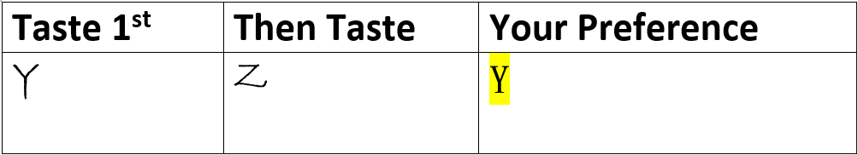
Step 5: Taste Test will begin
Room 200A
Room 205
Room 124
Half of your table will go to the other rooms to sample their products.
You need to sample from both rooms:
200A – Chocolate Chip Cookies and Coke 124 – Fudge Stripe Cookies and Sprites.
Don’t taste the products in your room
Please bring a pencil/ pen with you to the other rooms
Half of you will stay in this room to help the students coming to sample these products.
When someone from another room comes in have them First, get a sheet that tells them which item to taste 1st (Y or Z) and which item to taste 2nd (Y or Z). Second, they need to taste the products in that order. Third, they write their preference on the paper (Y or Z) and place it in the bucket. For example:
Repeat the steps above for the second item in the room. Once you have done both items in Room 200A then go to Room 124 and do the same thing.
Tasters should not discuss with each other or share their preference with anyone.
Tasters need to throw their trash away (don’t put on table put in the trash can).
When your table partners come back to their original room. Then those who stayed will go taste the food and those who have already tasted the food will stay and help.

Slide 9
Remember to go to both classes
Room 200A
Room 205
Room 124
Enter the classroom
(1) Get a paper telling you the order of items to taste
(2) Taste your first item then the second item
(3) Write your preference for the items you just tasted on the slip of paper and place in the bucket
Go to the next classroom
(6 ) Write your preference for the items you just tasted on the slip of paper and place in the bucket
(5) Taste your first item then the second item
(4) Get a paper telling you the order of the items to taste

Slide 10
Step 6: Clean up lab and Summarize data
After everyone has tasted the product clean up:
All uneaten samples need to be thrown away (or can be consumed by anyone).
Tables need to be wiped down.
Fill in Results Table (a handout will be provided by the lab instructor since the one in the book (table 8.4) uses a different randomization technique).
Fill in Table 8.5 on page 62 – summary of results.
Bargain brand is the Publix product.

Slide 11
Step 7: Answer all Discussion Questions
Use hand out provided to help you answer the questions correctly and completely.

Slide 12
Step 7: Answer all Discussion Questions
1. Did we use a random sample?
Note that most methods used later in the discussion questions to make inference require a random sample. If this was not a random sample then state that but still use the methods for inference.
2. Two ways attempted to control for factors other than taste that could affect preference.
3. Proportion preferring bargain (last value in table 8.5 on page 62).
7. Read the Reality Check

Slide 13
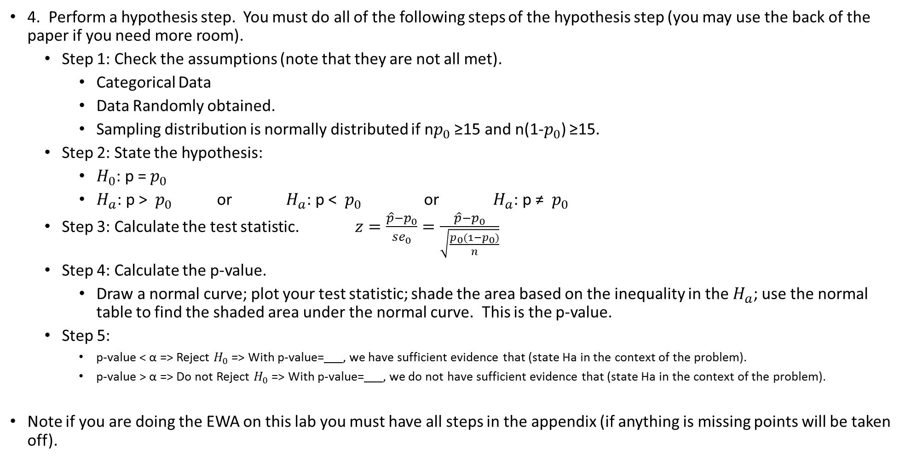
Step 7: Answer Discussion Questions
4. Perform a hypothesis step. You must do all of the following steps of the hypothesis step (you may use the back of the paper if you need more room).
Step 1: Check the assumptions (note that they are not all met).
Categorical Data
Data Randomly obtained.
Sampling distribution is normally distributed if n$p_{0}$ ≥15 and n(1-$p_{0}$) ≥15.
Step 2: State the hypothesis:
$H_{0}$: p = $p_{0}$
$H_{a}$: p > $p_{0}$ or $H_{a}$: p < $p_{0}$ or $H_{a}$: p ≠ $p_{0}$
Step 3: Calculate the test statistic. $z=\frac{\hat{p}−p_{0}}{{se}_{0}}=\frac{\hat{p}−p_{0}}{\sqrt{\frac{p_{0}(1−p_{0})}{n}}}$
Step 4: Calculate the p-value.
Draw a normal curve; plot your test statistic; shade the area based on the inequality in the $H_{a}$; use the normal table to find the shaded area under the normal curve. This is the p-value.
Step 5:
p-value < α => Reject $H_{0}$ => With p-value= , we have sufficient evidence that (state Ha in the context of the problem).
p-value > α => Do not Reject $H_{0}$ => With p-value= , we do not have sufficient evidence that (state Ha in the context of the problem).
Note if you are doing the EWA on this lab you must have all steps in the appendix (if anything is missing points will be taken off).

Slide 14
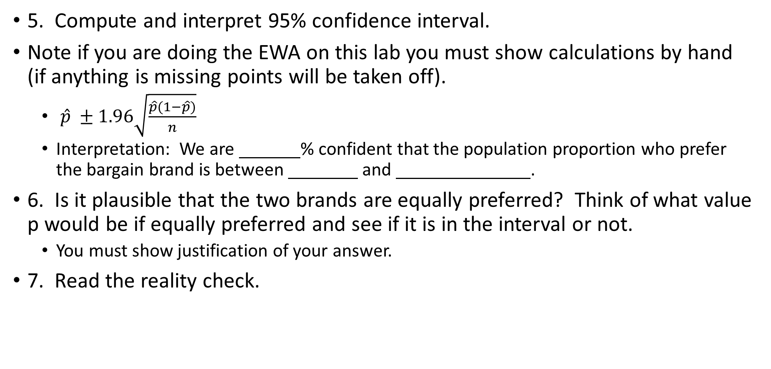
Step 7: Answer Discussion Questions
5. Compute and interpret 95% confidence interval.
Note if you are doing the EWA on this lab you must show calculations by hand (if anything is missing points will be taken off).
$\hat{p} ±1.96\sqrt{\frac{\hat{p}(1−\hat{p})}{n}}$
Interpretation: We are % confident that the population proportion who prefer the bargain brand is between and .
6. Is it plausible that the two brands are equally preferred? Think of what value p would be if equally preferred and see if it is in the interval or not.
You must show justification of your answer.
7. Read the reality check.

